Slide 1
Deterministic Finite Automaton (DFA) Regular Language
CSC3113: Theory of Computation
3
2
Summer 2020-2021
Dr. Hossain Md Shakhawat, Assistant Professor,
Department of Computer Science, Faculty of Science & Technology.
shakhawat@aiub.edu

Slide 2
Practice Problem with DFA.
Exercise solving from the book.
DFA design Issues.
Regular Language
Closure
Operations
Example: Regular Language closed under Union Operation

Slide 3
Understand, learn & practice with example
Practice designing DFA.
Learn Language, Regular Language & Regular Operations
Analyze Closure under regular Operation
Build one machine from 2 machine using closure under union

Slide 4
All outcome are represented with examples
Understand, learn & practice design of DFA.
Analyze and Design new machine model from one or more machine model(s) using closure rule of regular operation (example: Union).
In doing so, understand that, there are certain cases where DFA might not give a desired machine model.

Slide 5
DFA design issues
The key concept here is to understand the given language.
prepare input strings that the language gives
Match the pattern from left to right with the states & transitions of the state diagram, one by one.
First match the necessary conditions with the transition then complete the diagram with rest of the transition maintaining the rules.
Maintain the rules –
Single resultant state for an input symbol
Self-loop represents zero or more number of occurrences of input symbol.
There can be one or more number of final states.
Try to keep the number of states as minimum as possible
Make some of your own input strings based on the given language to test after designing your DFA (few ACCEPTED and few REJECTED).

Slide 6
Designing DFA – Example 1
Alphabet Σ={0,1,2}.
Language A₁ = {w : the sum of all the symbols in w is multiple of 3 }.
We design DFA for the language
“If the sum of symbols is multiple of 3 the DFA should accept it otherwise reject”
DFA: Single resultant state for an input symbol

Slide 7
∑ = {0,1}
A3 ={w : w is a binary string containing an odd number of 1s}
Alphabet
Language

Slide 8
A3 ={w : w is a binary string containing an odd number of 1s}.
A4 ={w : w is a binary string containing an even number of 0s}.
∑ = {0,1}
Alphabet
Language
0
0
1
q1
q2
A3
1
1
1
1
0
q1
0
q2
q3
A4
Can you make a better one for A₄ ?
0

Slide 9
Designing DFA – Example 1
0
Alphabet Σ={0,1,2}.
Language A₁ = {w : the sum of all the symbols in w is multiple of 3 }.
Can be represented as follows –
S= the sum of all the symbols in w.
If S modulo 3 = 0 then the sum is multiple of 3.
So the sum of all the symbols in w is 0 modulo 3.
We can model a_{i} as state representing S modulo 3 = i.
The finite state machine M₁= (Q₁, Σ, δ₁, q₁, F₁), where –
Q₁ = {a₀,a₁,a₂},
q₁ = a₀,
F₁ = {a₀},
δ₁
| 0 1 2 . a₀ | a₀ a₁ a₂
a₁ | a₁ a₂ a₀
a₂ | a₂ a₀ a₁
a₁
1
2
1
2
0
a₀
2
a₂
1
0
Input example: 01120101
Present State:
Input symbol:
Accepted
We design DFA for the language
a₂
a₁
a₀
“If the sum of symbols is multiple of 3 the DFA should accept it otherwise reject”
01120101
01120101
01120101
01120101
01120101
01120101
ε
01120101
01120101

Slide 10
Designing DFA – Example 2
Alphabet Σ={0,1,2}.
Language A₂ = {w : the sum of all the symbols in w is an even number }.
Can be represented as follows –
S= the sum of all the symbols in w.
If S modulo 2 = 0 then the sum is even.
Here, b_{i} is modeled as S modulo 2 = i.
The finite state machine M₂= (Q₂, Σ, δ₂, q₂, F₂), where –
Q₂ = {b₀,b₁},
q₂ = b₀,
F₂ = {b₀},
δ₂
| 0 1 2 . b₀ | b₀ b₁ b₀
b₁ | b₁ b₀ b₁
b₀
1
b₁
0,2
1
0,2
Input example: 01120101
Present State:
Input symbol:
Accepted
“If the sum of symbols is even the DFA should accept it otherwise reject”
b₀
b₁
01120101
01120101
01120101
01120101
01120101
01120101
01120101
01120101
ε

Slide 11
Let's design a DFA
Alphabet Σ={0,1,2}.
Language A₂ = {w : the sum of all the symbols in w is an odd number }.
b₀
1
b₁
0,2
1
0,2

Slide 12
A5 ={w| w ends with a 0}.
A6 ={w| w begins with a 1}.
A7 ={w| w begins with a 1 and ends with a 0}.
∑ = {0,1}
1
1
q1
0
q2
0
A5
q3
0, 1
0
q1
1
q2
0, 1
A6
q4
1
0, 1
0
q1
1
q2
0
q3
0
A7
1

Slide 13
A8 ={w| w has at least two 1s}.
A9 ={w| w has at most two 1s}.
∑ = {0,1}
0
0
0, 1
1
1
A8
q1
q2
q3
0
0
0
1
1
1
A9
q1
q2
q3
q4
0, 1

Slide 14
A10 ={w| w has substring 101}.
A11 ={w| w has substring 011}.
∑ = {0,1}
0
1
A10
1
0
q10
1
q101
qs
q1
0, 1
0
1
0
0
1
q01
1
q011
A11
qs
q0
0, 1
0
What happens for the language, A11 ={w| w does not have substring 011}?

Slide 15
A12={w| each 1 in w is followed by at least one 0}.
A12a={w| if any 1 in w is followed by at least one 0}.
∑ = {0,1}
0
1
0
A12
q1
1
q2
0
q3
q4
0,1
1
0
1
0,1
A12a
q1
1
q2
0
q3

Slide 16
A13 ={w | The length of w is at least three and have 0 in 2nd last position}
A14 ={w : The length of w is even and contains 1 in every odd position}
∑ = {0,1}
1
0
A13
0, 1
0
0, 1
q4
q1
q2
q3
1
1
A14
q1
1
q2
0, 1
q3
0
q4
0,1
0

Slide 17

Regular Expression ($∉$ exam)
A regular expression (also called rational expression or Regex) is a sequence of characters that define a search pattern, mainly for use in pattern matching in strings.
What is a regular expression and what makes it so important? Regex are used in Google analytics for URL or email address matching
Example : Regular expression for an email address : ^([a-zA-Z0-9_\-\.]+)@([a-zA-Z0-9_\-\.]+)\.([a-zA-Z]{2,5})$
If you are interested to learn how to write regex: https://www.geeksforgeeks.org/write-regular-expressions/

Slide 18
Regular Language
A regular language (or rational language) is a formal language that can be defined by a regular expression. In other words, a language is called regular if some finite automaton (DFA or NFA) accepts it.
Regular Operations: Let A={good, bad}, B = {boy, girl}.
Basic 3 operations used to study the properties of the regular languages –
Union: A∪B = {x : x ∈ A or x ∈ B} = {good, bad, boy, girl}.
Takes all the strings in both A and B and lumps them together into one language.
Concatenation: A • B = {xy : x ∈ A and y ∈ B} = {goodboy, goodgirl, badboy, badgirl}.
Attaches a string from A in front of a string B in all possible ways to get the strings in the new language.
Star: A* = {x₁x₂…x_{k} : k ≥ 0 and each x_{i} ∈ A} = {ε, good, bad, goodgood, goodbad, badgood, badbad, goodgoodgood, goodgoodbad, …}.
Attaching any number of strings in A together to get a string in the new language. It is a unary operation, where ε is always a member of A* (as ‘any number’ also includes 0).

Slide 19
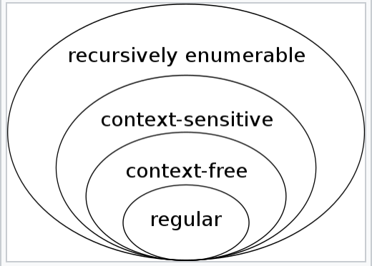

Regular Language ($∉$ exam)
Every regular language is context-free but every context-free grammar is not regular
The main difference between regular expression and context free grammar is that the regular expression help to describe all the strings of a regular language while the context free grammar helps to define all possible strings of a context free language.
Important subclasses of regular languages
Context-free grammar is a formal grammar in which every production(rewrite) rule is a form of V→w Where V is a single nonterminal symbol and w is a string of terminals and/or non-terminals. w can be empty
Context-sensitive grammar is a formal grammar in which left-hand sides and right hand sides of any production (rewrite) rules may be surrounded by a context of terminal and nonterminal symbols.
Notes:
To determine whether a string is contained in a CFG or a CSG, there are many approaches. First, you could build a recognizer for the given grammar. For CFGs, the pushdown automaton (PDA) is a type of automaton that accepts precisely the context-free languages, and there is a simple construction for turning any CFG into a PDA. For the context-sensitive grammars, the automaton you would use is called a linear bounded automaton (LBA).

Slide 20
Regular Language ($∉$ exam)
A regular language satisfies the following equivalent properties:
it is the language of a regular expression
it is the language accepted by a nondeterministic finite automaton (NFA)
it is the language accepted by a deterministic finite automaton (DFA)
it can be generated by a regular grammar
it can be generated by a prefix grammar
it can be accepted by a read-only Turing machine

Slide 21
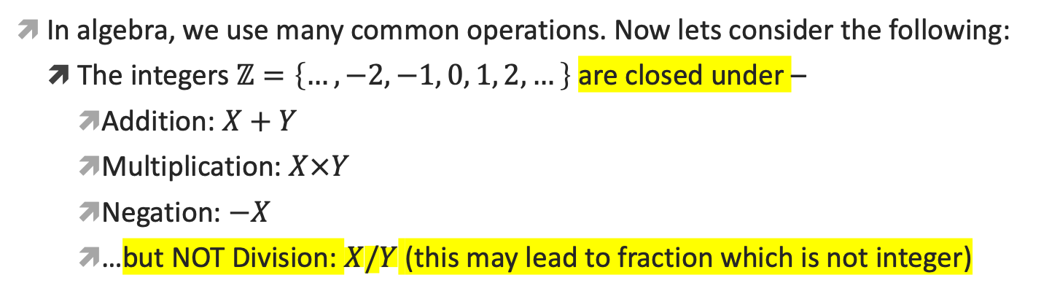
Regular Operations
Regular Language
Regular Operation
Here regular means DFA is involved
Here regular doesn’t mean DFA is involved; this regular could mean common
In algebra, we use many common operations. Now lets consider the following:
The integers $ℤ=\left\{…,−2,−1, 0, 1, 2,…\right\}$are closed under –
Addition: $X+Y$
Multiplication: $X×Y$
Negation: $−X$
…but NOT Division: $X/Y$ (this may lead to fraction which is not integer)
We’d like to investigate similar closure/closed properties for regular languages

Slide 22
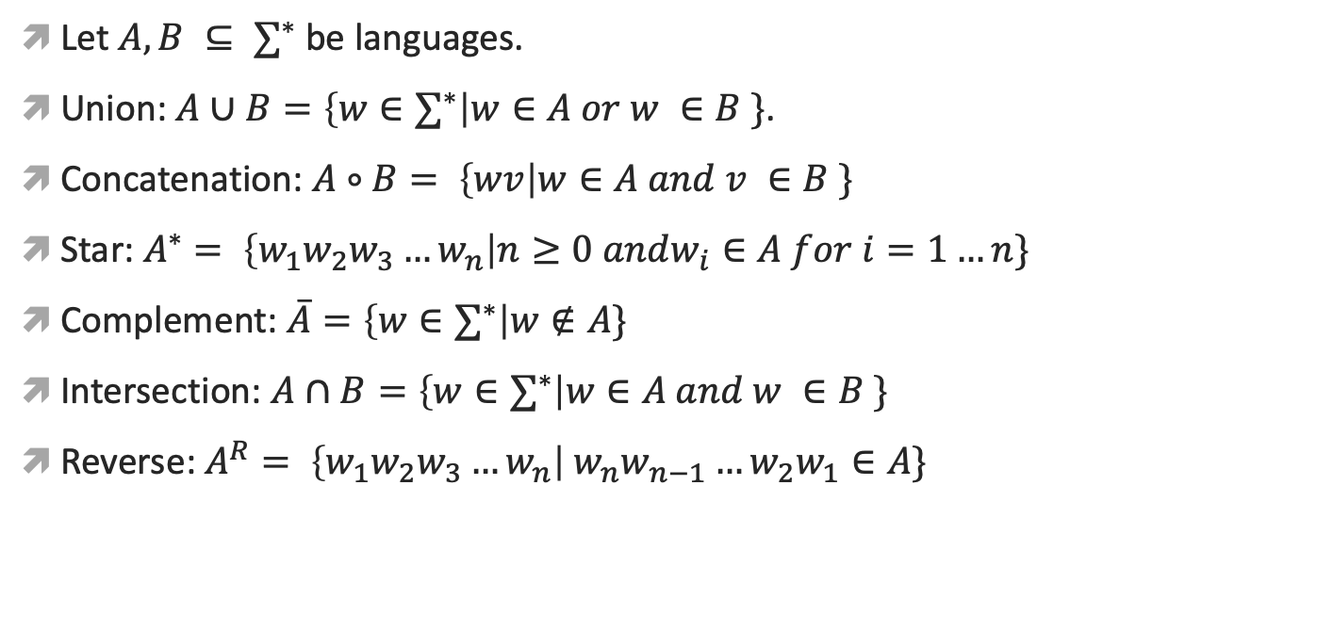
Regular operations on languages
Let $A, B ⊆ ∑^{∗}$ be languages.
Union: $A∪B=\left\{w∈∑^{∗}\right|w∈A or w ∈B \}$.
Concatenation: $A∘B= \left\{wv\right|w∈A and v ∈B \}$
Star: $A^{∗}= \left\{w_{1}w_{2}w_{3}…w_{n}\right|n≥0 andw_{i}∈A for i=1…n\}$
Complement: $\overline{A}=\left\{w∈∑^{∗}\right|w∉A\}$
Intersection: $A∩B=\left\{w∈∑^{∗}\right|w∈A and w ∈B \}$
Reverse: $A^{R}= \left\{w_{1}w_{2}w_{3}…w_{n}\right|{ w}_{n}w_{n−1}…{w_{2}w}_{1}∈A\}$

Slide 23
Meaning of Closure/CLOSED
A collection of objects is closed under some operation, if applying that operation to the members of the collection returns an object which also belongs to that collection
Closure/closed property of regular languages are defined as certain operations for regular language which are guaranteed to produce regular language as a result.
Theorem: The class of regular languages is closed under all three regular operations (union, concatenation, star), as well as under complement, intersection, and reverse. if set A and B are regular, applying any of these operations on these sets yields a regular language.
Next, we will prove it for Union operation.
How do we prove that the resultant language is also regular?
Ans: if the resultant language is recognized/accepted by DFA it means its regular

Slide 24
Regular Language closed under Union
We will prove it by construction.
Let M₁ recognize A₁, where M₁= (Q₁, Σ, δ₁, q₁, F₁), and M₂ recognize A₂, where M₂= (Q₂, Σ, δ₂, q₂, F₂).
Construct M to recognize A₁∪ A₂, where M = (Q, Σ, δ, q₀, F).
Q = {(r₁, r₂) : r₁ ∈ Q₁ and r₂ ∈ Q₂}.
Q = Q₁ × Q₂. (All combination of states of machine M₁ and M₂).
Σ = Σ₁ ∪ Σ₂.
But here, for simplicity, we have considered Σ₁ = Σ₂ to be same.
For each (r₁,r₂) ∈ Q and each a ∈ Σ, let δ((r₁,r₂), a) = (δ(r₁, a), δ(r₂, a)).
Hence δ gets a state of M (which actually is a pair of states from M₁ and M₂), together with an input symbol, and returns M’s next state.
q₀ is the pair (q₁, q₂).
F = { (r₁, r₂) : r₁ ∈ F₁ or r₂ ∈ F₂ }
F = (F₁ × Q₂) ∪ (Q₁ × F₂)

Slide 25
DFA Union Example
Let,
M₁= (Q₁, Σ, δ₁, q₁, F₁), where –
Q₁ = {a₀,a₁,a₂},
Σ = {0, 1, 2}
q₁ = a₀,
F₁ = {a₀},
δ₁
| 0 1 2 . a₀ | a₀ a₁ a₂ a₁ | a₁ a₂ a₀ a₂| a₂ a₀ a₁
M₂= (Q₂, Σ, δ₂, q₂, F₂), where –
Q₂ = {b₀,b₁},
Σ = {0, 1, 2}
q₂ = b₀,
F₂ = {b₀},
δ₂
| 0 1 2 . b₀ | b₀ b₁ b₀ b₁ | b₁ b₀ b₁
M= (Q, Σ, δ, q₀, F), where –
Q = {(r₁, r₂) : r₁ ∈ Q₁ and r₂ ∈ Q₂} = Q₁ × Q₂ Q = {(a₀,b₀), (a₀, b₁),(a₁, b₀), (a₁, b₁),(a₂, b₀), (a₂, b₁)},
Σ = Σ₁ ∪ Σ₂ = {0, 1, 2}
q₀ = (q₁,q₂) = (a₀, b₀)
F = { (r₁, r₂) : r₁ ∈ F₁ or r₂ ∈ F₂ } = (F₁ × Q₂) ∪ (Q₁ × F₂) F = {(a₀, b₀), (a₀, b₁)} ∪ {(a₀, b₀), (a₁, b₀), (a₂, b₀)}
F = {(a₀, b₀), (a₀, b₁), (a₁, b₀), (a₂, b₀)}
δ | 0 1 2 . (a₀, b₀) | (a₀, b₀) (a₁, b₁) (a₂, b₀) (a₀, b₁) | (a₀, b₁) (a₁, b₀) (a₂, b₁) (a₁, b₀) | (a₁, b₀) (a₂, b₁) (a₀, b₀) (a₁, b₁) | (a₁, b₁) (a₂, b₀) (a₀, b₁) (a₂, b₀) | (a₂, b₀) (a₀, b₁) (a₁, b₀) (a₂, b₁) | (a₂, b₁) (a₀, b₀) (a₁, b₁)
The above finite automata machine should give the same output for any given input to machine M₁ or M₂.
Here M₁ recognizes A₁ and M₂ recognizes A₂. So M should recognize A = A₁ ∪ A₂.
A₁= {w: sum of all the symbols in w is multiple of 3}.
A₂ = {w: sum of all the symbols in w is even}.
Machine 1
(a₀, b₀) (a₁, b₁) (a₂, b₀) (a₀, b₁) (a₁, b₀) (a₂, b₁) (a₁, b₀) (a₂, b₁) (a₀, b₀) (a₁, b₁) (a₂, b₀) (a₀, b₁) (a₂, b₀) (a₀, b₁) (a₁, b₀) (a₂, b₁) (a₀, b₀) (a₁, b₁)
Machine 2

Slide 26
DFA Union Simulation
2
0
(a₁,b₀)
(a₀,b₀)
(a₂,b₀)
2
2
0
0
1
1
1
1
(a₂,b₁)
(a₁,b₁)
2
2
2
0
0
1
(a₀,b₁)
1
0
Input example: 01120101
Input symbol:
Accepted

Slide 27
Closure under Concatenation
Let M₁ recognize A₁, where M₁= (Q₁, Σ, δ₁, q₁, F₁), and M₂ recognize A₂, where M₂= (Q₂, Σ, δ₂, q₂, F₂).
Construct M to recognize A_{1°}A₂, where M = (Q, Σ, δ, q₀, F).
M must accept if its input can be broken into two pieces where M₁ accepts the first piece and M₂ accepts the second piece.
Problem: M doesn’t know where to break its input. i.e., where the first part ends and the second begins.
To solve the problem we will learn a new technique called nondeterministic automaton.

Slide 28
Elements of the Theory of Computation, Papadimitriou (2nd ed), DFA + Exercise.
Introduction to Automata Theory, Languages, and Computation (3rd ed), DFA + Exercise.

Slide 29
QA
Definition − The Kleene star, ∑*, is a unary operator on a set of symbols or strings, ∑, that gives the infinite set of all possible strings of all possible lengths over ∑ including λ.
If ∑ = {a, b}, ∑* = {λ, a, b, aa, ab, ba, bb,………..}
A language is a subset of ∑* for some alphabet ∑. It can be finite or infinite

